Slide 1
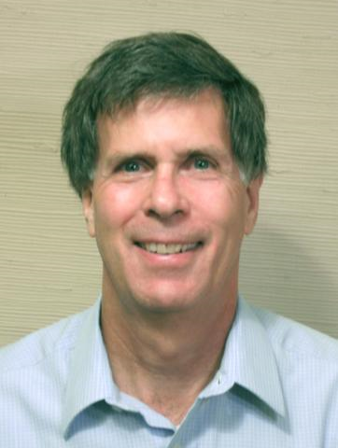
Planning for the Next Version of QIF – Continuing
Thomas (Tom) Kramer
Thomas Kramer Consulting
QIF Developer & Software Developer
next QIF, June 14, 2022

Slide 2
Issues Status
Excel next QIF issues list
completely reorganized by issue type
estimated time for studying (if needed) and making changes is given for each issue
for almost all issues there is a recommendation for QIF 3.1 and QIF 4.0
a handful of issues are still not clear enough to propose a resolution
Received version 0.8 draft from the Model-Based Characteristics Working Group
proposed changes not yet added to the Excel issues list
few explicit requests for changes
first impression: many changes will be needed
Still need input from
Capvidia
next QIF, June 14, 2022

Slide 3
Issue Categories (refer to the Excel issues list)
- needed technical changes: technical changes with little or no effect on implementers or users (15)
- straightforward changes needed for Y14.5 or ISO GPS conformance (4)
- not-very-extensive changes that seem needed (38)
- large important existing areas needing improvement (6)
20 items on Excel issues sheet but most of them are in non-contact measurement
- large important areas not yet in QIF (5)
- information technology issues (2)
- issues requiring further study (17)
- issues needing better description (6)
next QIF, June 14, 2022

Slide 4
Please review recommendations
The Excel spreadsheet from today will be available on the internet.
Please review recommendations for issues you are interested in and comment.
next QIF, June 14, 2022

Slide 5
Requirements Document
A requirements document has been started but cannot reasonably be completed until Capvidia provides its list of suggested changes.
The requirements document will focus on recommended changes to QIF (including additions).
The recommendations will be based on what seems doable and worthwhile.
next QIF, June 14, 2022

Slide 6
Next Steps
Hear from Capvidia
Take poll of DMSC members on going to version 3.1 or version 4.0
two choices: 3.1 or 4.0
3.1 would be backward compatible with 3.0 files. 4.0 would not
Take “investment” poll of DMSC members on importance of 7 major areas
Each member gets a pile of “dollars” (probably 14). Spend any number of the dollars in any of the seven areas according to importance to your company.
Finish requirements document
Include Gantt chart in document
Probably four to six concurrent activities
next QIF, June 14, 2022

Slide 7
Existing Major Areas Needing Improvement
Large areas in which some work has already been done, but more is needed
- Welding (a new working group would be needed)
- Surface finish/coating (a new working group would be needed)
- Non-contact metrology (from NCM working group)
- QIF plans (the working group will need to be revived)
- FMEA (Failure Modes and Effects Analysis)
a draft model in XSDL exists but has not been examined by the DMSC
- Process control data for specific industries
QIF covers the aerospace AS9102B standard now but could do more for automotive
next QIF, June 14, 2022

Slide 8
New Major Areas
No work has been done, but these may be desirable. Each would need a new working group.
- Gear metrology
- Additive manufacturing metrology
- MEMS and microelectronics metrology
- Manufacturing
- Part and assembly tests beyond size and shape, including functional tests
next QIF, June 14, 2022

Slide 9
Comment on Issues and Recommendations
qif-community issues list (open access)
https://github.com/QualityInformationFramework/qif-community/issues
qif-dev issues list (restricted access)
https://github.com/QualityInformationFramework/qif-dev/issues
email to
TomRKramer2@gmail.com
next QIF, June 14, 2022

Slide 10
The end
Please help define the next QIF! The DMSC needs your participation.
Questions?
next QIF, June 14, 2022

